Slide 1

UNDERSTANDING THE PROPERTY TAX AMENDMENT:
What’s Really at Stake
Presented by [Name]
[Audience/event name]
This material was not prepared with public funds and is intended for good faith use in compliance with sec. 106.113 (2), Fla. Stat. | Publication date: June 2026
Notes:
Welcome the audience. Thank them for coming.
Introduce yourself and your role. Mention how long you've served on the city commission.
Frame the next 15 minutes.
There is a constitutional amendment on the November ballot that would change how our city is funded.
We’re going to walk through what the amendment actually does and what the data says it would cost our community.
Note: Speaking in your personal capacity.

Slide 2
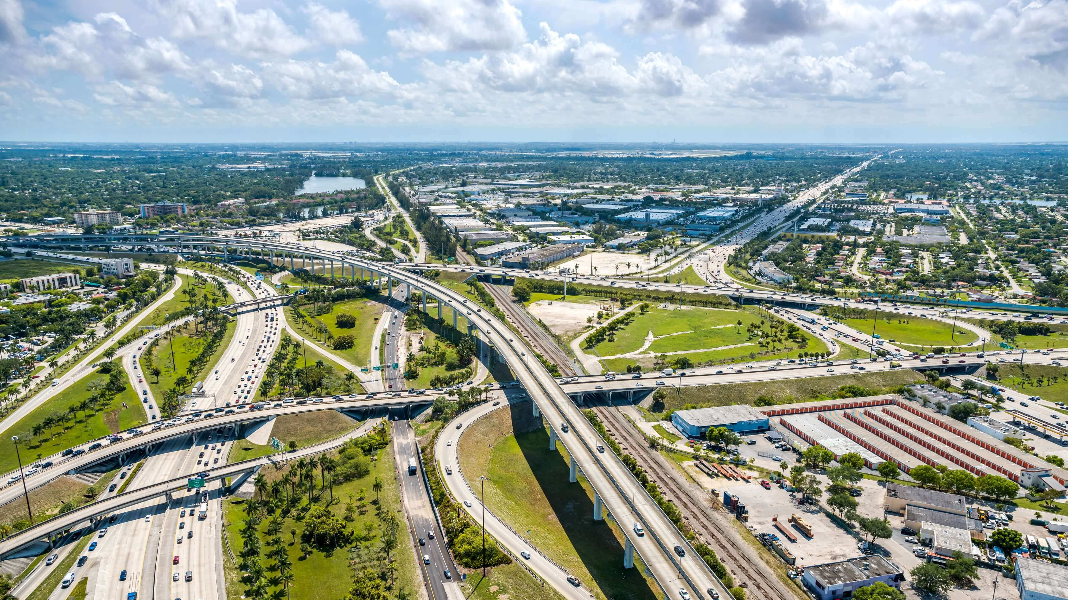
WHAT’S BEING PROPOSED
If approved, the amendment would:
Increase the homestead property tax exemption from $50,000 to $150,000, beginning January 1, 2027
Further increase the exemption to $250,000, beginning January 1, 2028
Reduces the cap on annual assessment increases for non-homestead properties from
10% to 5%
Reduces the largest local revenue source
Does NOT change the cost of services.
Does NOT create a state trust fund, so there is no replacement revenue.
Source: HJR 203, 2026 Regular Session
Notes:
The ballot title is “Save Our Homes from Excessive Property Taxes.”
But there’s a gap between what the title says and what the amendment does.
That gap is what we’re talking through today.
If passed, the amendment would:
Increase the homestead property tax exemption from $50,000 to $150,000, beginning January 1, 2027
Further increase the exemption to $250,000, beginning January 1, 2028
Reduce the largest local revenue source
Reduce the cap on annual assessment increases for non-homestead properties from 10% to 5%
But, in reality, this does not change the cost of providing core services, and it does not identify replacement revenue. In fact, the Legislature removed the state trust fund that was intended to be a backfill.

Slide 3
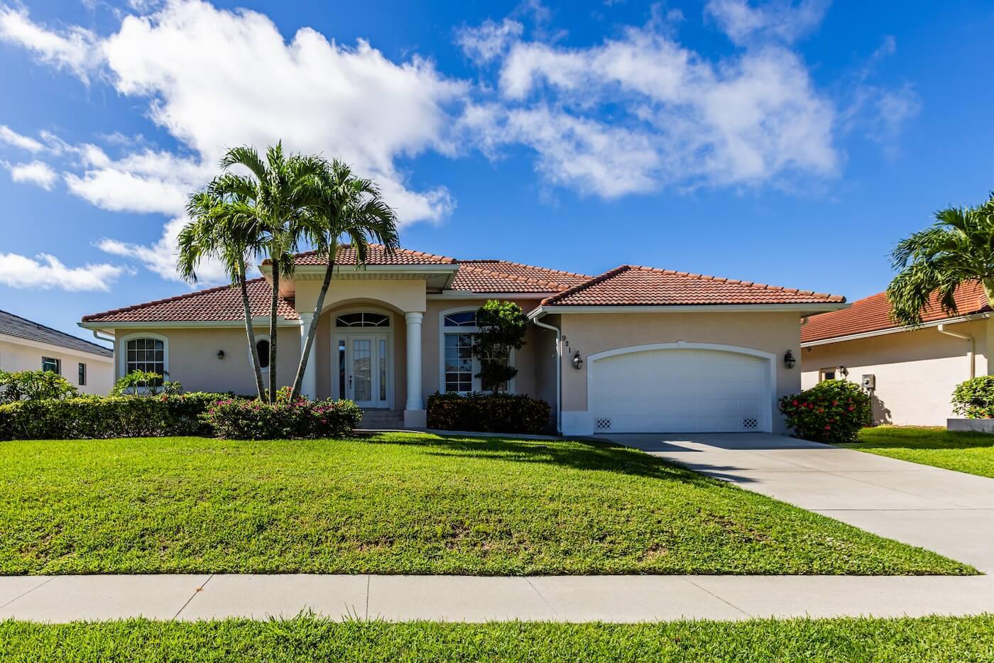
THE NUMBERS TELL THE STORY
$5
$8.8
56%
BILLION
BILLION
Lost revenue for local governments in year one
(Source: Revenue Estimating Conference)
Lost revenue for local governments in year two
(Source: Revenue Estimating Conference)
Public safety accounts for more than 56% of cities’ general fund spending statewide
(Source: Wichita State/FIU, Dec 2025)
Notes:
Let's put some real numbers behind what this amendment would mean for local governments.
According to the Revenue Estimating Conference, the $250,000 homestead exemption would reduce funding for local governments by roughly $5 billion in the first year, and that grows to nearly $8.8 billion the following year.
That's not a small adjustment — that's a massive reduction.
Public safety makes up more than half of cities' general fund spending statewide.

Slide 4
WHAT THIS MEANS FOR OUR CITY
[CITY NAME] Property Tax Picture
X%
SHARE OF THAT REVENUE SPENT ON PUBLIC SAFETY
$X
PROJECTED ANNUAL REVENUE LOSS IN YEAR ONE
$X
ANNUAL
PROPERTY TAX REVENUE
This amendment cuts that funding without changing what cities are required to deliver.
Notes:
Note: This slide requires local data. OMIT SLIDE OR UPDATE SLIDE with city-specific numbers.
Note: Walk through what property taxes fund in your city.
This amendment cuts the funding without changing what cities are required to deliver. The amendment reduces the money. It does not remove the obligation.

Slide 5
UNINTENDED
CONSEQUENCES
1. Tax Shift
2. Cut Critical Services
Or Both
Notes:
Either the tax burden must shift onto other taxpayers to make up the difference, or, cities are forced to cut services that residents rely on every day.
The proposal does not reduce the cost of running a city — it just changes who pays and what gets funded.

Slide 6
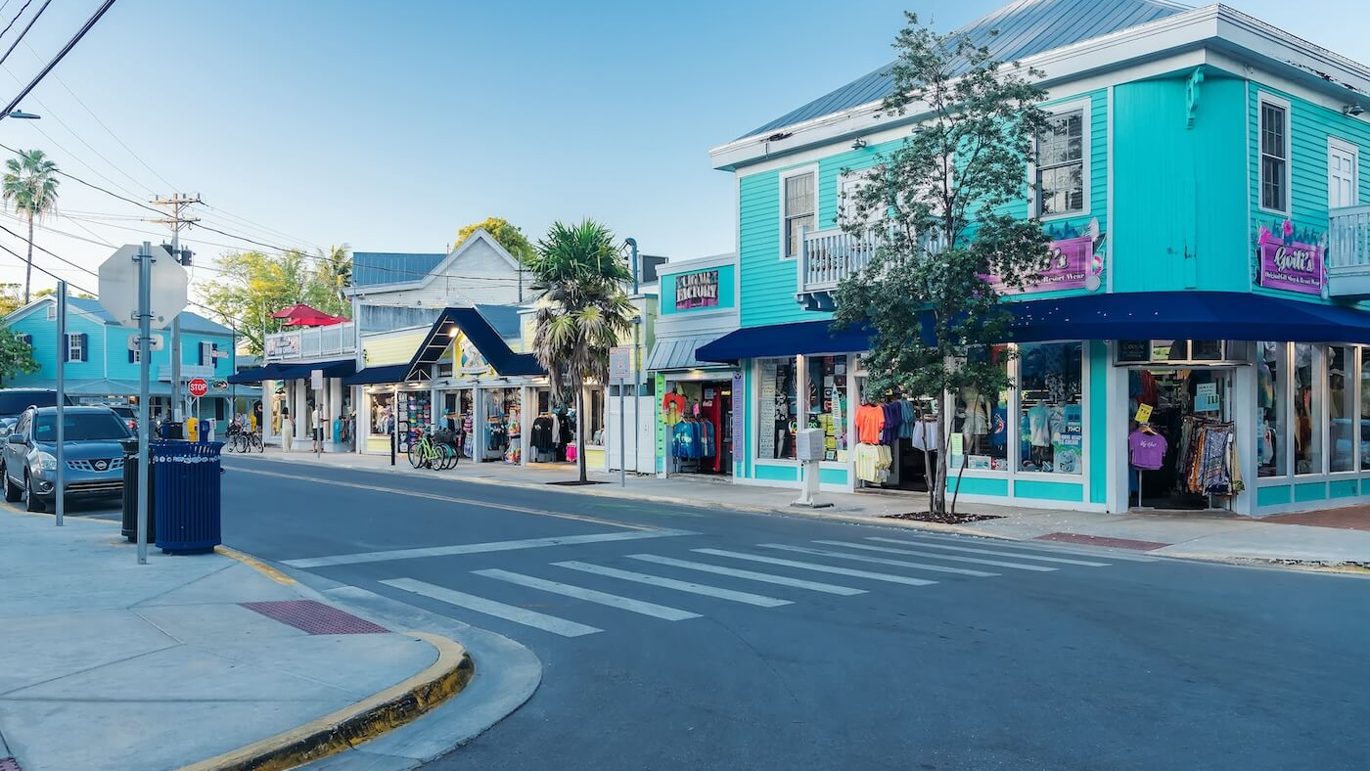
IT’S A TAX SHIFT, NOT A TAX CUT
The amendment removes revenue. The cost of services does not change.
Homeowners below $250,000:
smaller city bill, but the cost shifts to other taxes, fees, and local prices.
Homeowners above $250,000:
absorb a larger share through higher millage rates — subsidizing those below.
One person’s tax exemption is another person’s tax increase.
Notes:
The amendment removes revenue from city budgets. The cost of running the city does not change. Police still patrol. Fire still responds. Roads still need repair.
Homeowners below $250,000 see a smaller bill from the city. The cost lands somewhere else. It lands on other taxes. It lands on fees. It lands on the prices local businesses charge.
Homeowners with property above $250,000 absorb a larger share through higher millage rates on the remaining tax base and are forced to subsidize those below it.

Slide 7
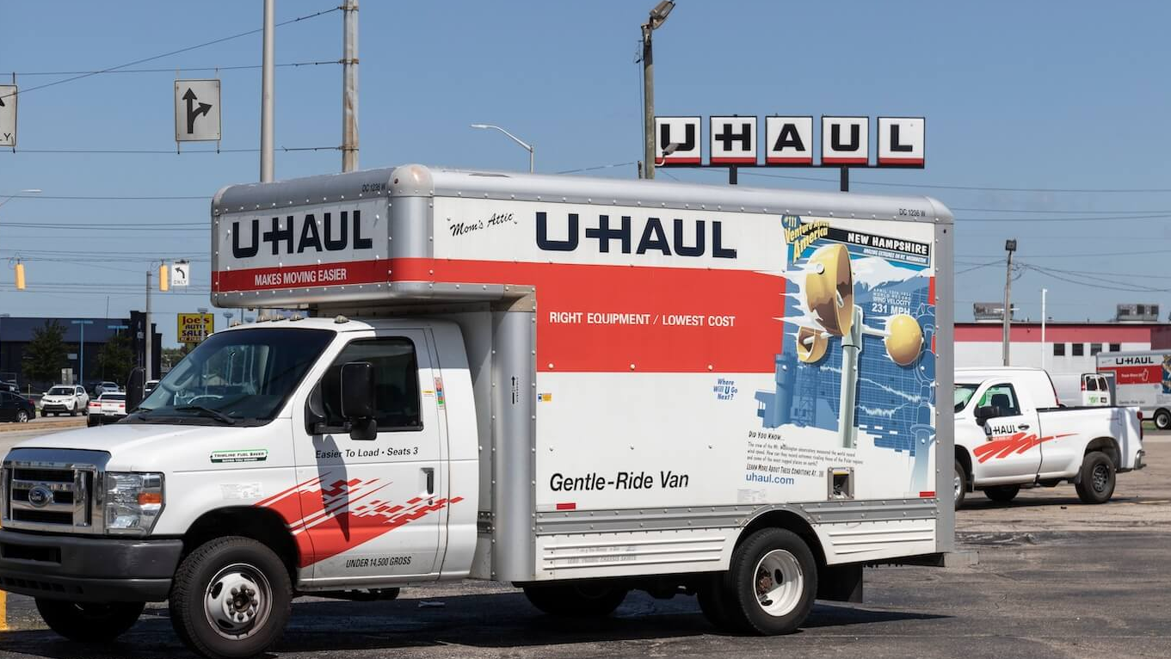
WHO ELSE PAYS MORE UNDER A TAX SHIFT
Local businesses:
Higher non-homestead property taxes, rent,
and local fees → passed on to customers as higher prices
Consumers:
Costs passed along at the register
Renters:
No homestead benefit, but landlords' taxes go up → rent goes up
First-Time Homebuyers:
Five-year residency requirement disqualifies many
That’s not a tax cut. That’s a tax shift.
Notes:
Who else pays more?
Local businesses, because this amendment treats all businesses the same. They will pay higher taxes and fees, and then pass that expense onto consumers through higher prices on things like gas and groceries.
Renters. They don’t receive the homestead benefit, but since their landlord’s taxes are going up on their non-homesteaded properties, their rent is likely to go up too.
And, first-time homebuyers, who don’t meet the five-year resident requirement.

Slide 8
FLORIDA IS A HURRICANE STATE
Local governments need to respond fast when storms hit
Property taxes are a steady, local resource that lets cities act immediately — not wait on Tallahassee or Washington
Stable funding keeps crews ready and recovery moving, so families and businesses bounce back sooner
Strong local revenue = strong local recovery
Notes:
When storms hit, local governments need to respond fast — there's no time to wait.
Property taxes are a steady, local resource that lets cities act immediately, instead of waiting on the state or FEMA.
Local governments also need a healthy reserve to handle post-storm recovery — things like debris removal and flood recovery — that have to start the moment the storm passes.
Federal reimbursements eventually come, but they're slow — and they shouldn't be relied on as the primary source of emergency response funding.
History has shown that the communities with cash on hand are the ones that recover sooner. They can hire crews, clear roads, get power back up.
Stable funding is what keeps crews ready and recovery moving forward — so families and businesses can bounce back sooner.

Slide 9
BONDS AND INFRASTRUCTURE
Property tax revenue backs the bonds cities issue to build and maintain infrastructure.
That means less ability to finance roads, stormwater, utilities, public facilities.
SMALLER TAX BASE
=
LOWER BONDING CAPACITY
=
HIGHER INTEREST RATES
Less money
for essential services today.
Less capacity to fund critical needs tomorrow.
More traffic.
Slower emergency response.
Greater vulnerability during storms.
Notes:
Here's something a lot of people don't realize: property tax revenue backs the bonds cities issue to build and maintain infrastructure.
When the tax base shrinks, so does a city's bonding capacity, and that means higher interest rates. The riskier you look on paper, the more you pay to borrow.
That translates into less ability to finance the things that keep you moving — roads, stormwater systems, utilities, and public facilities.
When we don’t invest in those things, the impact shows up in everyday life: more traffic, slower emergency response times, and greater vulnerability when the next storm hits.
The bottom line: taxpayers end up paying more and getting less.

Slide 10

SALES TAXES ARE A BAD BACKUP PLAN
  65 of 67 Florida counties already levy a local surtax. Most have no room to raise it further.
  Once local communities hit the ceiling, the pressure moves to Tallahassee to raise the state sales tax
  Sales taxes collapse in downturns — they fell sharply in 2008 and during COVID
  Property taxes have historically been stable and predictable through both
Public safety, emergency response, roads, and water systems can't rely on a revenue source that drops every time the economy slows.
Sources: Florida Department of Revenue; Florida Economic and Demographic Research
Notes:
Some have suggested sales taxes could fill the gap, but the math just doesn't work.
65 of 67 Florida counties already levy a local surtax, and most have no room left to raise it.
Once counties hit the ceiling, the pressure moves to the state to raise the state sales tax.
In fact, the Tax Foundation found that sales taxes would need to be 15% to fully replace property taxes.
And here's the bigger problem — sales taxes collapse in downturns. They fell sharply in 2008 and again during COVID.
Property taxes, on the other hand, have historically been stable and predictable through both.
You can't fund 911 with a revenue source that disappears in a recession.

Slide 11
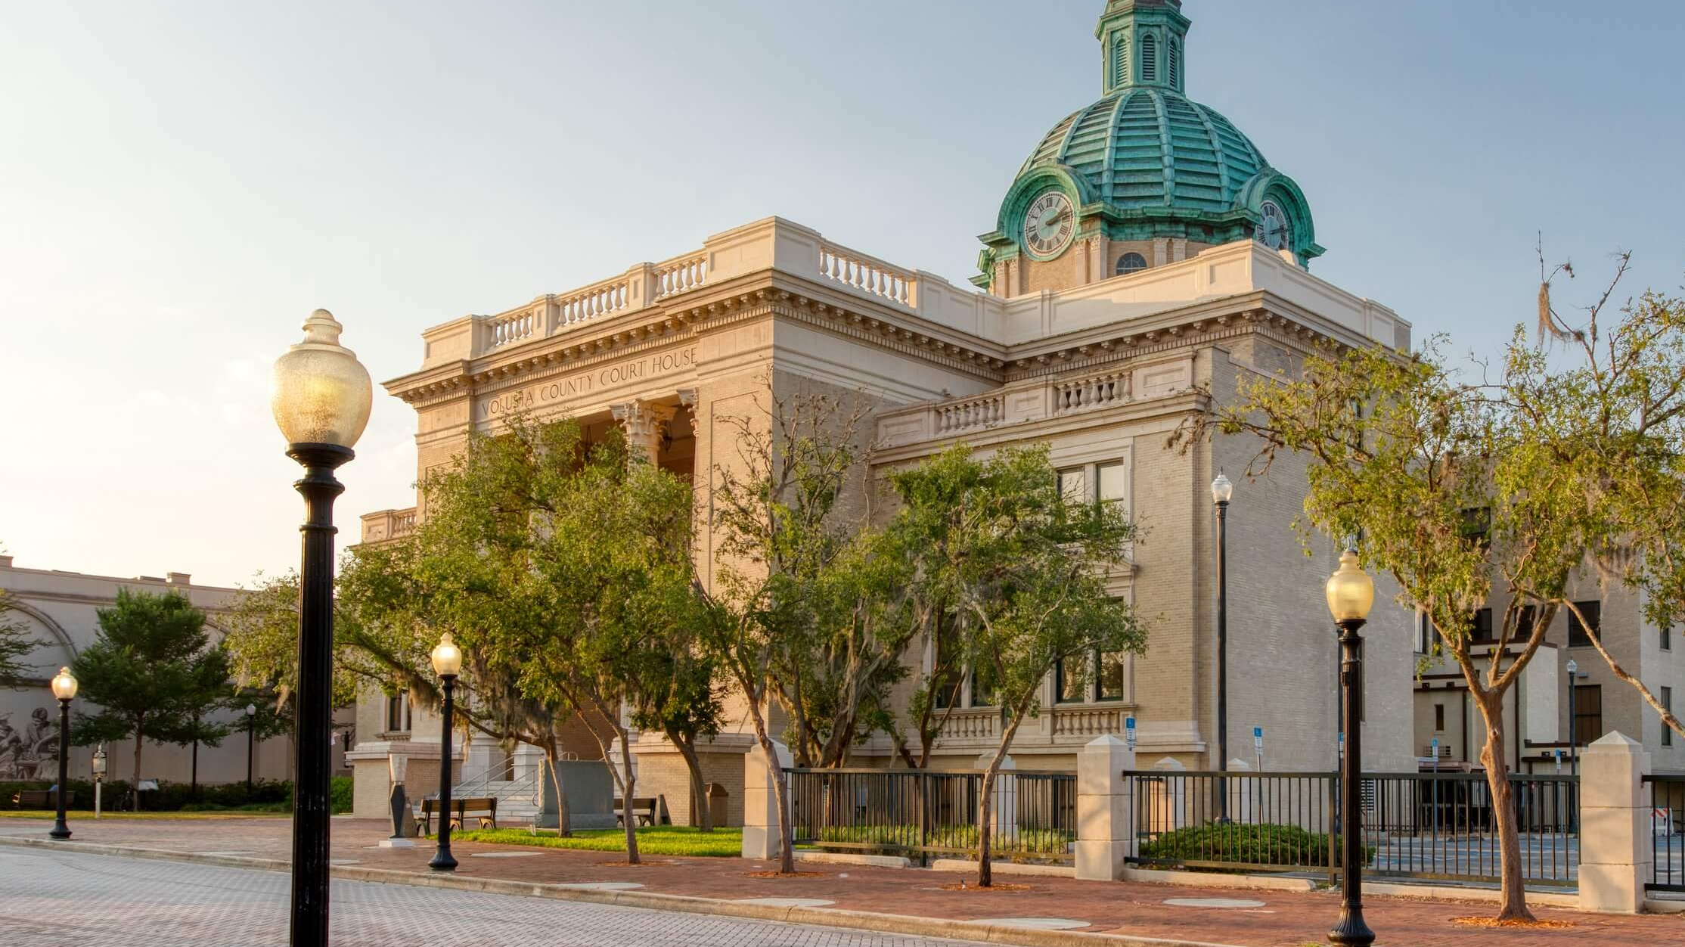
THE BOTTOM LINE
It's not a tax cut —
It's a tax shift.
It doesn't protect public safety —
It defunds it.
It doesn't empower communities —
It makes them dependent on the state.
Notes:
So, when you put it all together, here’s the bottom line of this proposed amendment.
It's not a tax cut. It's a tax shift. The cost of running a city doesn't go away; it just moves to someone else's bill.
It doesn't protect public safety. It slashes it. Without the revenue to back it up.
And it doesn't empower communities. It makes them dependent on the state.
That's the choice in front of Florida. And that's why this conversation matters.

Slide 12
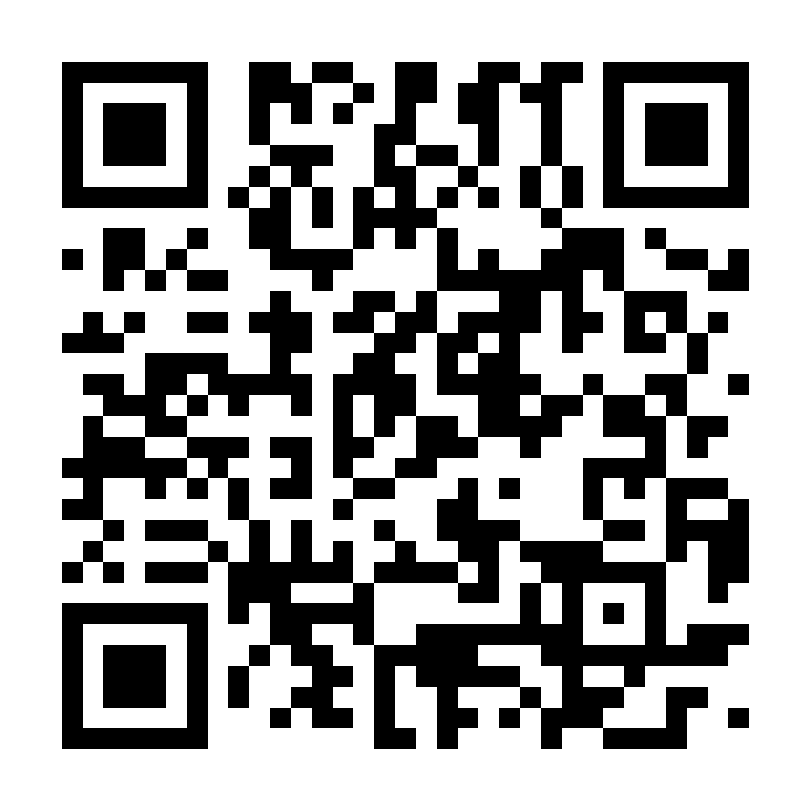
WHAT YOU CAN DO
Read the amendment carefully before November.
Share what you've learned with your neighbors, friends, and family.
Talk to people you know in other Florida cities.
The impact reaches every community in the state.
Scan here for the facts, the sources, and the data.
This material was not prepared with public funds and is intended for good faith use in compliance with sec. 106.113 (2), Fla. Stat. | Publication date: June 2026
Notes:
The amendment will be on the November 2026 ballot.
What I would ask is this. Read the amendment. Share what you've learned. Talk to people you know in other Florida cities.
The more our neighbors understand what's actually in this amendment, the better they can decide for themselves.
Scan the QR code here for more information.
Thank you for being here today, and for being part of this conversation about the future of Florida's cities

