Slide 1
Zika: Front Line Response Through Local Partnership
Zerry Ihekwaba, Ph.D., P.E.
Assistant City Manager
City of Miami
Florida League of Cities: Research Symposium
Embassy Suites Hotel, Orlando, Florida
December 7, 2016

Slide 2
Zika Virus – Local Time Capsule
Vectors: Aedes Aegypti mosquito, human and breeding sites
February 2016: Governor Rick Scott declare Zika Emergency
City of Miami: response through citywide cleanup campaign
February 12, 2016: Governor Scott directed the State Surgeon General to activate a Zika Virus Information Hotline, 1-855-622-6735 managed by the Department of Health

Slide 3
Zika in City of Miami
July 2016: the Centers for Disease Control and Prevention (CDC) announce Zika Virus transmitted locally in Miami Wynwood area
City activates Zika Zone Response Task Force
July 15: Wynwood Zika zone announcement
July 29: Reports of business closures in Wynwood area
August 1: CDC issue first travel warning ever issued for the continental United States for pregnant women to avoid Wynwood
September 29: Little River Zika zone announcement

Slide 4
Zika Zones in City of Miami
Wynwood Zika zone: first neighborhood where CDC declared a travel advisory for pregnant women because of Zika; between NW 5 Ave and Biscayne Blvd and NW/NE 20 St and NW/NE 36 St
Little River Zika zone: between N.E. 79 and 63 streets from N.W. 10 Ave to North Miami Ave
“Keep Miami Beautiful” is our vehicle for Zika response

Slide 5
Goal: Keep Miami Beautiful, Healthy and Safe
Address Code compliance, illegal dumping, enhanced citywide surveillance, slum and blight
Develop community partnerships to spearhead neighborhood pride

Slide 6
Zika Zone Response Task Force
Weekly Schedule
Strategy Sessions: Mon / Wed / Fri
Zika Zone and adjoining hotspots outside boundary
Mandate: F.S. 162.06 Enforcement procedure.— (1) It shall be the duty of the code inspector to initiate enforcement proceedings of the various codes…
Task-force work

Slide 7
Zika Zone Response Task Force
Miami Police
Code Compliance
Solid Waste
Public Works
Building
Fire Rescue
Communications
Parks and Recreation
Neighborhood Enhancement Team

Slide 8
Local Stakeholder Collaboration
Florida Department of Health
Miami-Dade County Mosquito Control
Florida Department of Transportation
Downtown Development Authority
Miami Parking Authority
Business Improvement Districts
HOAs, CBOs, FBOs, etc.

Slide 9
Task Force Response Plan 1
Miami Police Department: public safety, distribute repellent and outreach to officers and homeless population
Code Compliance: investigate overgrown lots, illegal dumping, open dumpsters, outdoor storage, etc.
Solid Waste: illegal dumping, bulk pickup, remote recycling and coordination of commercial solid waste franchisees
Public Works: street inspections, standing water, public drains and trash holes

Slide 10
Task Force Response Plan 2
Building: building sites, construction storage bins, open trenches, abandoned swimming pools, and standing water
Fire Rescue: Public outreach; emergency response
Neighborhood Enhancement Team: Public outreach, educational programs, public meetings with HOAs, CBOs, and BIDs, etc.
Communications: information dissemination thru TV, Website and Social Media
Parks: parklands and playgrounds; outreach to users, parents and children; Landscape improvement

Slide 11
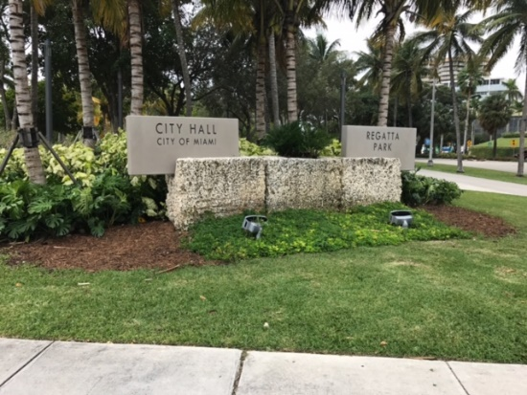
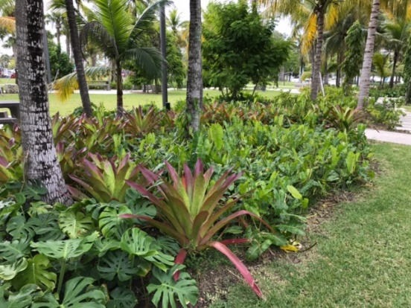
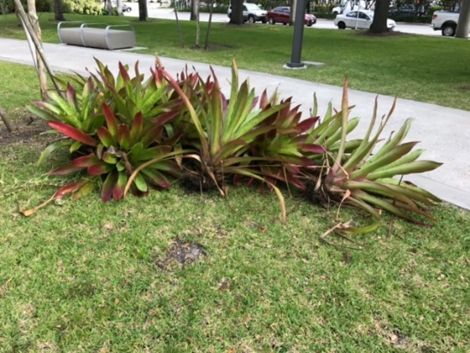
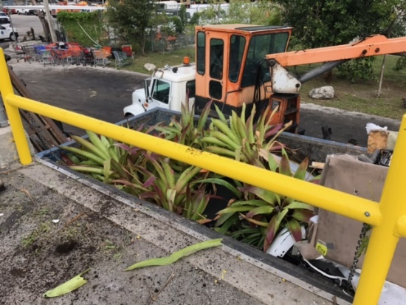
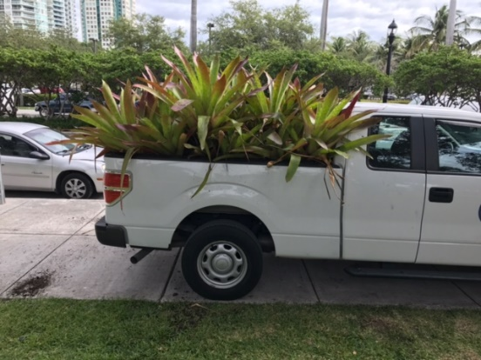
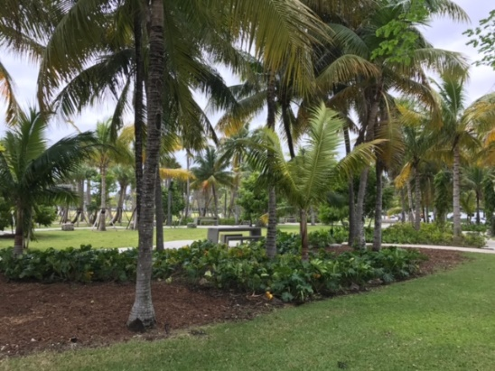
Removal of Bromeliads at Regatta Park

Slide 12
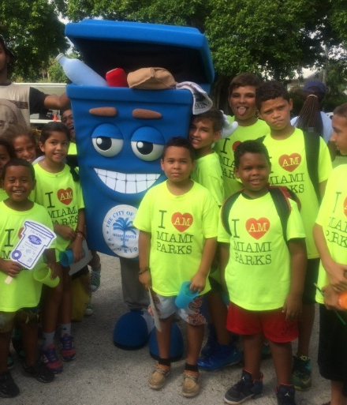
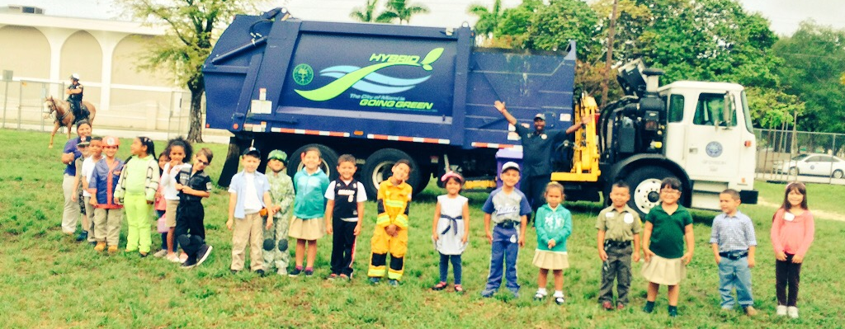
Public Outreach
Social Media, TV & Websites - posted Zika information from City, CDC, FDOH
Distributed informational flyers thru NET, FIRE, MPD, HOAs, CBOs and BIDs
Share information: print and electronic media; Street Bus Shelters and Ad Panels
Visit to Schools and Parks
Promote Recycling

Slide 13
Operational Challenges - 1
Better and prompt communication needed between all agencies
Lack of transparent information on where to concentrate initial efforts in designated Zika zones
Limited community in-person meetings in designated Zika transmission zones
Public outreach is done by multiple agencies in the same areas; this could be better coordinated through strategy sessions

Slide 14
Operational Challenges - 2
Large scale rapid response is difficult due to number of storm water inlets and time required to clean them and apply larvicides
Potholes and damaged swale areas may hold standing water
Paved swales, turf blocks, and erosion control structures in parking areas and swales hold small puddles that are slow to drain
Illegal Dumping - Abandoned structures, Mattresses, and Buckets/Containers
Vacant and/or abandoned lots with restricted access

Slide 15
Operational Challenges - 3
Vacant properties and roof with planters that hold stagnant water
Backyards without access
Absentee landlords
Multi-ethnic city with conflicting cultural issues and sensitivity
Information dissemination in different languages (English, Spanish and Creole) for materials, cards, flyers, PSAs, etc.

Slide 16
Operational Challenges - 4
Legislative Restraints: Code enforcement officers have to wait for seven (or ten) days to correct property violations though Zika virus infestation is public health threat
Illegal storage or dumping of tires, mattresses, buckets and other containers that store water or act as mosquito breeding sites
Overgrown lots that pose public health concern
Uncontrolled plantings and landscape improvements in private properties – plantings that hold water and flower pots

Slide 17
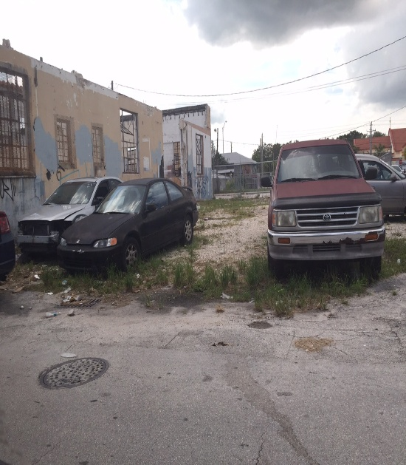
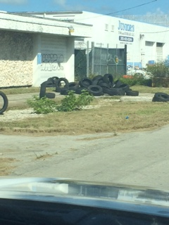
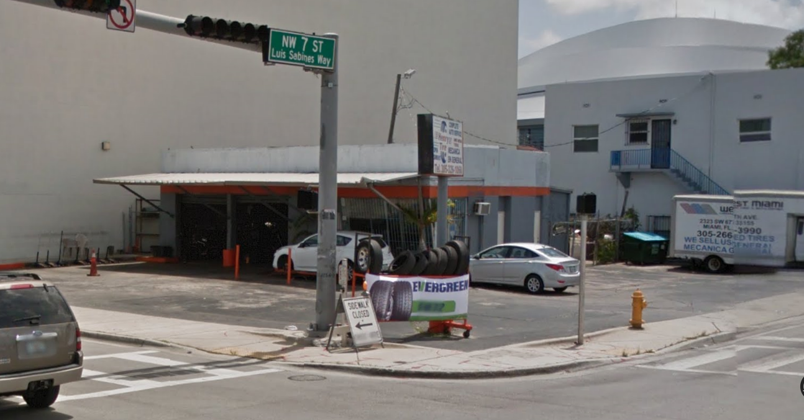
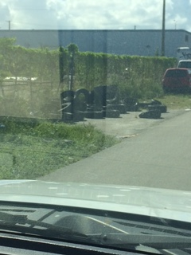
Auto-Repair and Body Shops
Auto-Repair and Body Shops: Public display of tires, storage areas and undocumented disposal process

Slide 18
LESSONS LEARNED: Operational, Legal and Public Health

Slide 19
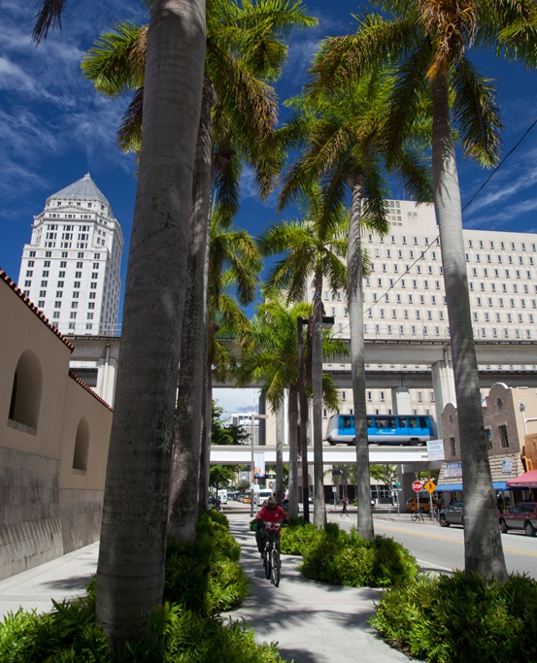
Design and Policy Changes
Revise landscape design standards: No structures that hold water outdoors; prescribe self-draining systems
Update prohibited plant specie inventory: No Bromeliads, etc., in public spaces and streets
Code Enforcement: adopt a realistic compliance period

Slide 20
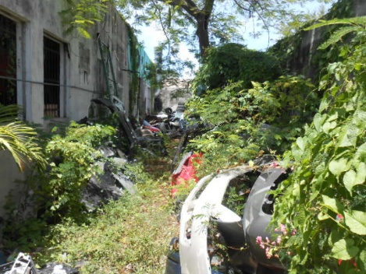
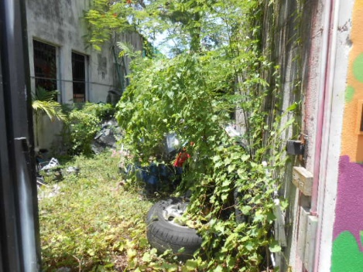
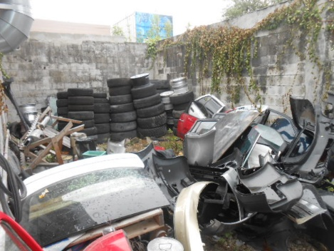
Citizen Self-Surveillance is helpful
My backyard is my private property; but it is not an approved storage
Good neighbors are your brother’s keeper
Citizen participation and Google Image Search
Code Enforcement is key to safe and healthy neighborhood

Slide 21
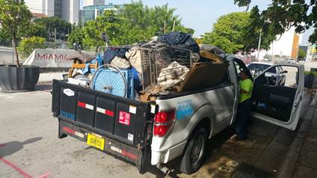
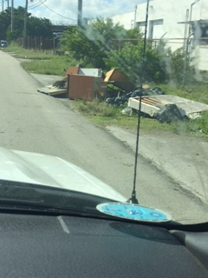
Law Enforcement at Hotspots
MPD Environmental Crimes Unit
Illegal Dumping: Install cameras in public places and Street hotspots
Code Enforcement: escalate process and compliance
Waste or Used Tires

Slide 22
Title XXIX, Ch. 403, Public Health, Environ Control, F.S.
403.718 Waste tire fees.
(1) For the privilege of engaging in business, a fee for each new motor vehicle tire sold at retail…is imposed on any…retail sales of new motor vehicle tires within this state... Such fee shall be imposed at the rate of $1 for each new tire sold.
(2) The fee imposed by this section shall be reported to the Department of Revenue…The proceeds of the waste tire fee, less administrative costs, shall be transferred by the Department of Revenue into the Solid Waste Management Trust Fund.

Slide 23
Title XXIX, Ch. 403, Public Health, Environ Control, F.S.
403.717(3)(b) “It is unlawful for any person to dispose of waste tires or processed tires in the state except at a permitted solid waste management facility…”
403.717(5)(a) “The department shall encourage the voluntary establishment of waste tire collection centers at retail tire-selling businesses, waste tire processing facilities, and solid waste disposal facilities, to be open to the public for the deposit of waste tires.”
403.717(5)(b) “The department may establish an incentives program to encourage individuals to return their waste tires to a waste tire collection center. The incentives may involve the use of discount or prize coupons, prize drawings, promotional giveaways, or other activities the department determines will promote collection, reuse, volume reduction, and proper disposal of waste tires.”
403.031(2) Definitions.—In construing this chapter, or rules and regulations…(2) “Department” means the Department of Environmental Protection.

Slide 24
Legislative Changes
Auto-Repair and Body Shops: Display tires, and audit of waste or used tire disposal
Review provisions of Ch. 403.717, F.S. regarding Waste Tires

Slide 25
Recommendation
Identify gaps in existing laws and regulations that would impede recovery in new situations such as emerging diseases
Review Ch. 162 and Ch. 403, F.S. to address enhanced/rapid response to Code violations that threaten public health
Recommend Exemption Clause in case of emergencies and threats to public health
Fiscal Impact – make realistic budgetary provision
Funding…partnership of local, state and federal agencies needed

Slide 26
Is Miami Zika Free?
Wynwood Zika zone: lifted September 19th
Little River Zika zone: lifted December 2nd
Zika zone is lifted if 45 days have passed without local transmission of the mosquito-borne virus in the zone
Florida DOH and Gov Rick Scott declarations a relief but effort to be sustained

Slide 27
Zika: the fight is not over
Unfortunately, the vectors are here to stay
“We can’t take this for granted. We have to understand that we’re going to have to continue to fight this until we get a vaccine.” - Gov. Rick Scott
CDC says “don’t let down guard”

Slide 28
Zika: But the fight is not over!
Miami Zika Task Force
is now a permanent feature of municipal service delivery

Slide 29
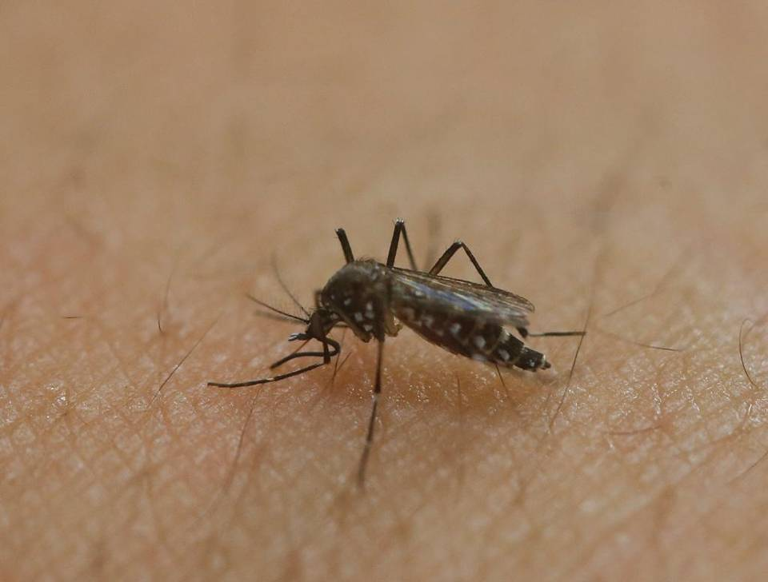
Zika: Yes, the fight is not over
Aedes aegypti mosquito

