Slide 1
City of Stuart
Lessons from Disasters
We Didn’t See Coming
Mayor Jeff Krauskopf
e

Slide 2
Past, Present, Future Water Flow

Slide 3
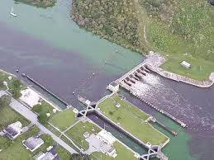
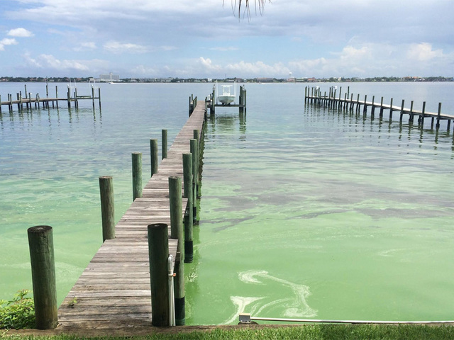
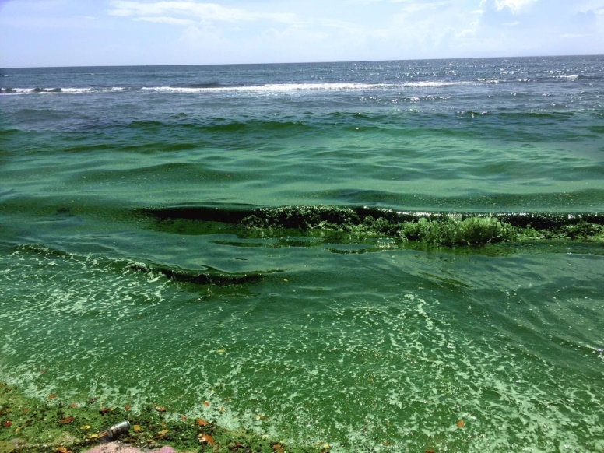
East Coast Environmental Conditions

Slide 4
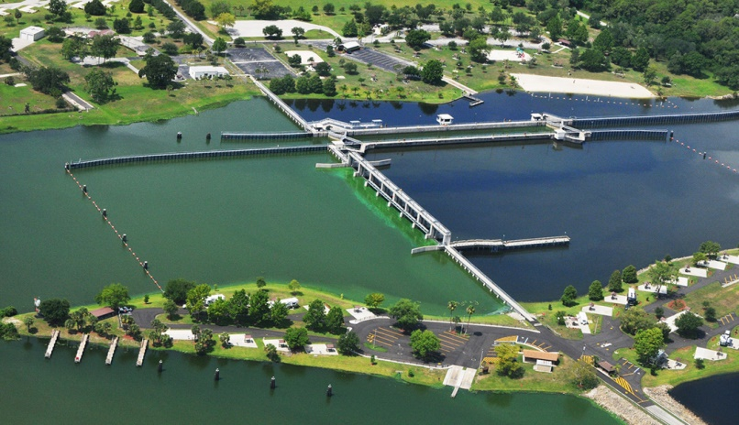
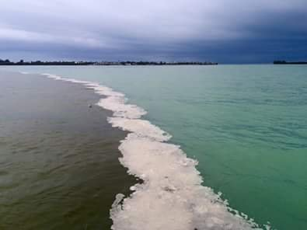
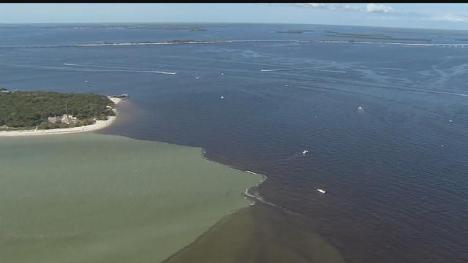
West Coast Environmental Conditions

Slide 5
Economic Impact
County | 2015 Population | Current Tourist Development Tax Rate Percentage | Total TD Taxes | 2015 Total Just Value All Property Types | 2015 Total Assessed Value All Property Types | 2015 Total Taxable Value All Property Types
Broward | 1,827,367 | 5% | $1,827,367.00 | $224,087,008,814.00 | $190,654,243,992.00 | $150,623,153,459.00
Charlotte | 167,141 | 5% | $167,141.00 | $19,591,032,262.00 | $17,047,338,572.00 | $13,154,406,553.00
Collier | 343,802 | 4% | $343,802.00 | $90,999,965,960.00 | $79,324,399,038.00 | $70,088,827,067.00
Dade (Miami-Dade)* | 2,653,934 | 6% | $2,653,934.00 | $345,348,235,999.00 | $282,475,672,084.00 | $230,036,394,474.00
DeSoto | 34,777 | 3% | $34,777.00 | $3,175,741,472.00 | $1,955,250,008.00 | $1,387,223,022.00
Glades | 12,853 | 2% | $12,853.00 | $3,234,261,272.00 | $1,404,491,736.00 | $561,010,487.00
Hardee | 27,645 | 0% | $27,645.00 | $3,279,671,525.00 | $1,972,971,678.00 | $1,540,923,939.00
Hendry | 38,096 | 3% | $38,096.00 | $5,361,098,890.00 | $3,245,390,150.00 | $1,812,071,084.00
Highlands | 100,748 | 2% | $100,748.00 | $6,838,477,713.00 | $6,484,955,382.00 | $4,508,483,473.00
Indian River | 143,326 | 4% | $143,326.00 | $20,640,095,535.00 | $17,749,719,621.00 | $14,301,405,281.00
Lee | 665,845 | 5% | $665,845.00 | $87,338,998,450.00 | $74,744,964,052.00 | $62,686,090,992.00
Martin | 150,062 | 5% | $150,062.00 | $26,387,345,321.00 | $22,770,951,434.00 | $18,633,364,511.00
Monroe* | 74,206 | 5% | $74,206.00 | $31,459,482,260.00 | $27,464,216,717.00 | $21,596,270,894.00
Palm Beach | 1,378,417 | 6% | $1,378,417.00 | $217,610,910,675.00 | $181,898,452,086.00 | $152,562,817,106.00
St. Lucie | 287,749 | 5% | $287,749.00 | $25,665,201,528.00 | $22,173,162,154.00 | $16,322,236,568.00
Sarasota | 392,090 | 5% | $392,090.00 | $65,508,568,792.00 | $56,863,120,753.00 | $46,542,124,786.00
Regional Total | 8,298,058 |  | $8,298,058.00 | $1,176,526,096,468.00 | $988,229,299,457.00 | $806,356,803,696.00
Regional Average |  | 4% | $518,628.63 | $73,532,881,029.25 | $61,764,331,216.06 | $50,397,300,231.00
Regional Median |  | 5% | $158,601.50 | $26,026,273,424.50 | $22,472,056,794.00 | $17,477,800,539.50

Slide 6
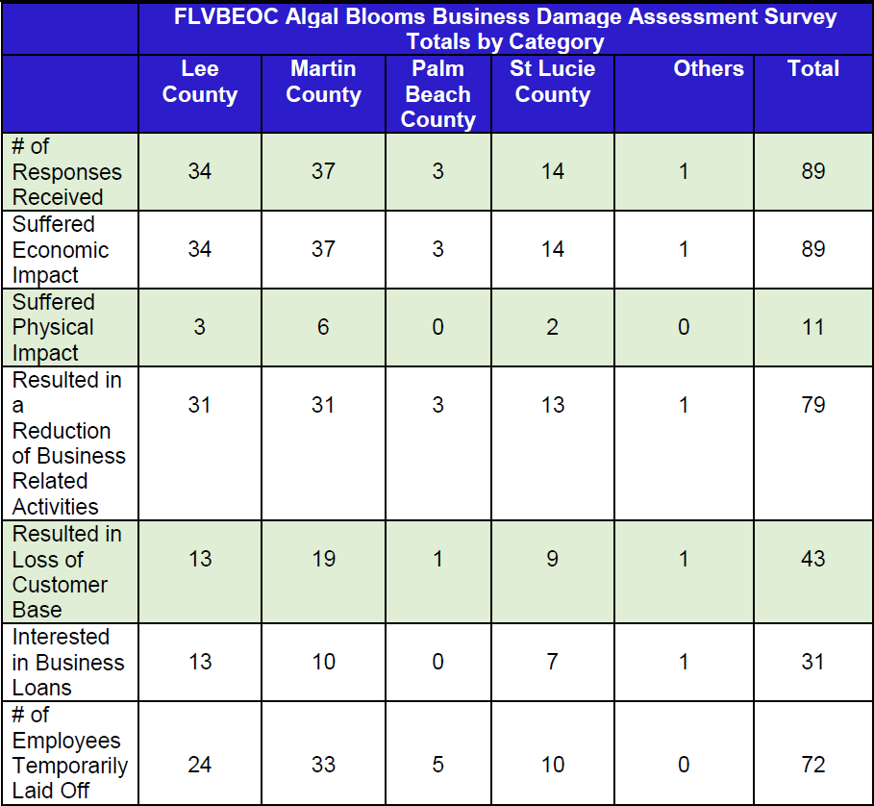
Florida Virtual Business Emergency Operations Center

Slide 7
Communicating with the Public
Rebuilt City Community Services Department and hired a new Public Information Officer
Designed a new City Communications Plan
Established new protocols and opened new channels of communications with other local, state, and federal agencies to produce consistent messaging
Expanded communications outreach to social media platforms to reach a wider audience

Slide 8
Lake Okeechobee Regional Initiatives
Collaborative effort among east coast, west coast, and central areas to address economic, ecological, and environmental factors
Grown from a learning collaborative into a regional compact initiative among 19 counties & 164 cities
Dedication of staff time to produce compact language and to address possible solutions in the future
Reassures residents that problems are being addressed at local levels with the greatest sense of urgency

Slide 9
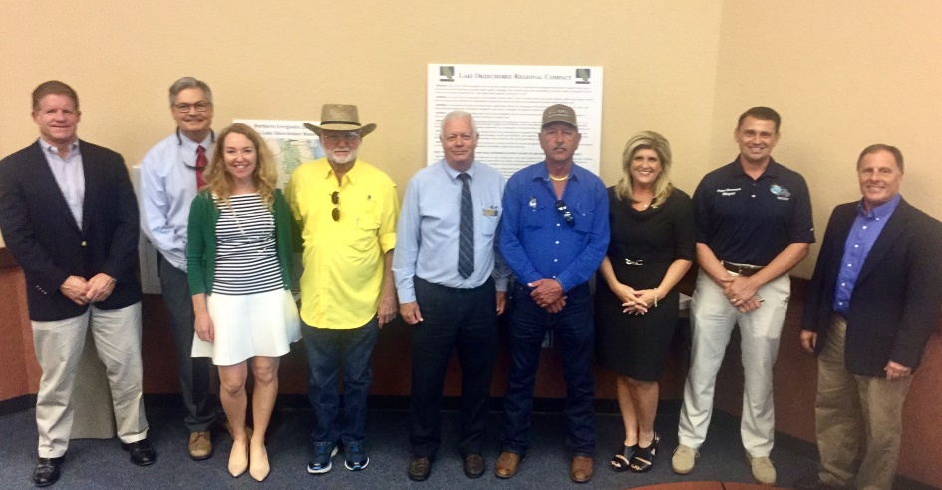
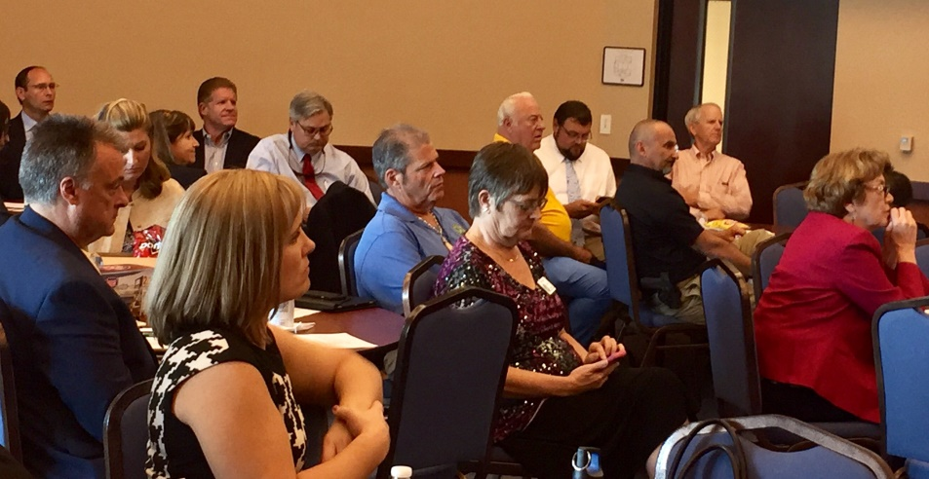
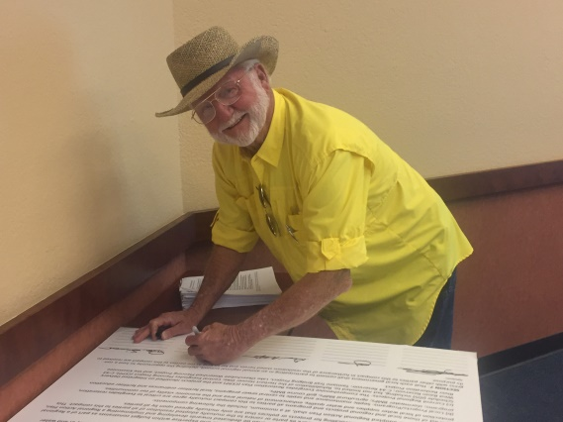
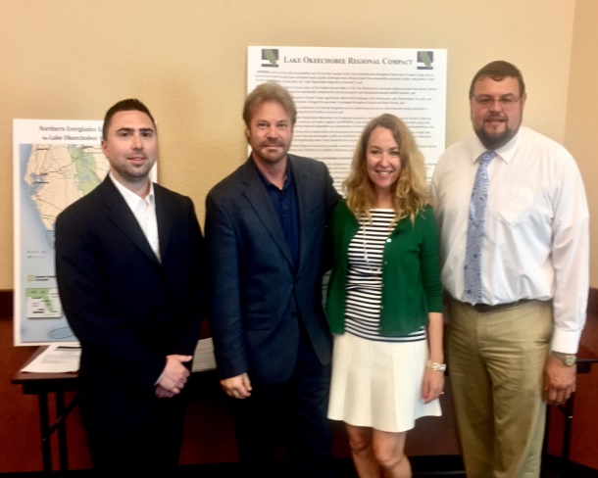
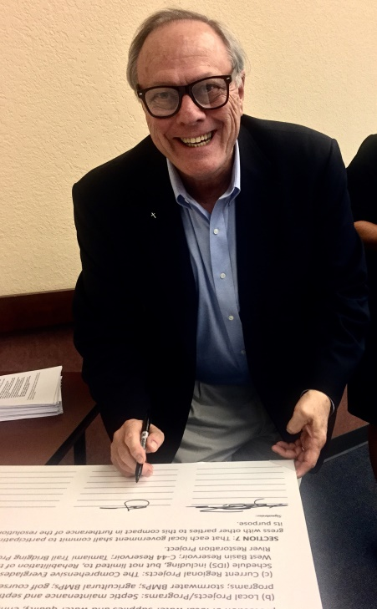
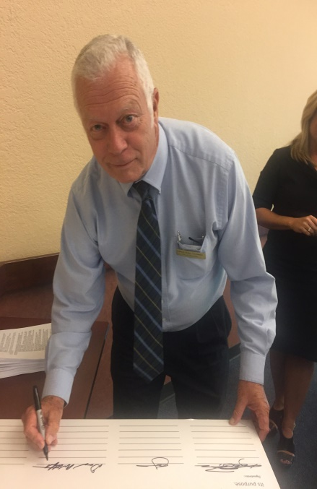
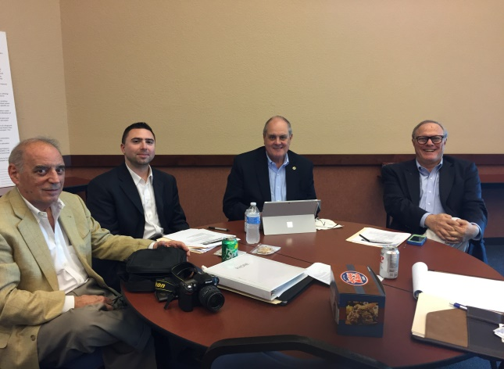
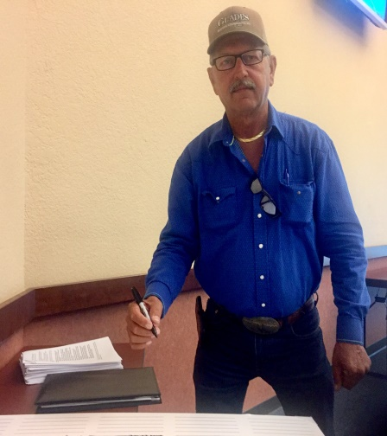
Compact Signing - Nov. 30 2016

Slide 10
Lessons Learned
Consistency in communication among municipal partners and to external agencies is essential
Problems that stem from beyond municipal jurisdictions require consideration of state and federal priorities and impacts
Regional collaboration strengthens advocacy and protects the interests of all involved

